Slide 1
LAB 6 Assignment - Sharding & Scalability and Performance
Vidhya Venugopal (8902970)

Slide 2

Database Sharding
Vidhya Venugopal (8902970)

Slide 3
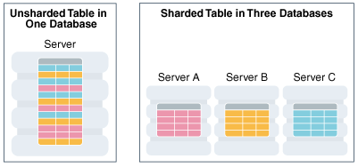
Why we need sharding
In the age of Big Data, popular social media platforms and IoT sensor data, datasets are huge. If such a dataset is stored in a single database, queries become slow
A single logical dataset is split into multiple databases that are then distributed across multiple machines. When a query is made, only one or a few machines may get involved in processing the query
Sharding enables effective scaling and management of large datasets. There are many ways to split a dataset into shards
Sharding is possible with both SQL and NoSQL databases
Database replication, partitioning and clustering are concepts related to sharding

Slide 4
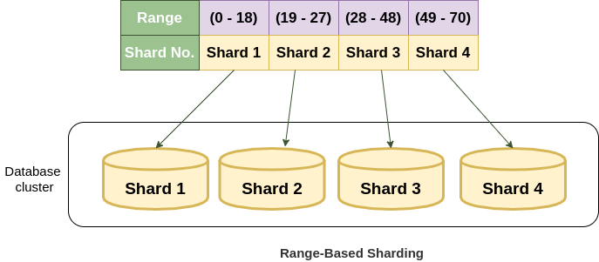
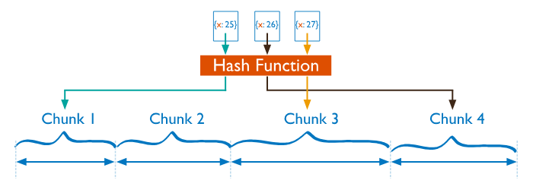
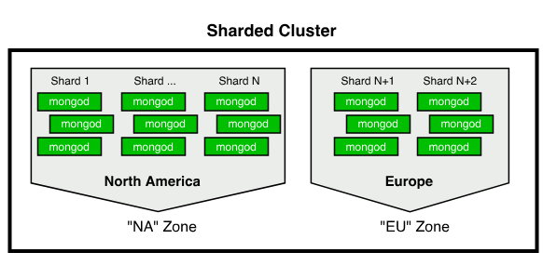
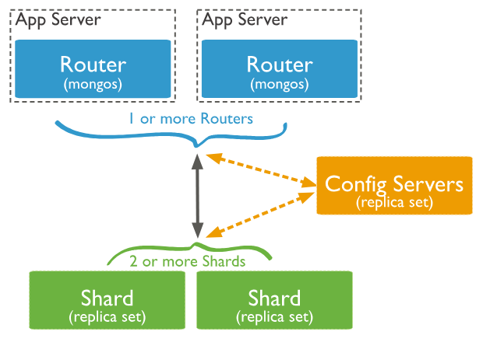
Sharding Types and Architectures
Ranged/dynamic sharding
Range-based sharding involves selecting data values and assigning them to a shard based on whether they fall within a specific range.
Key-based sharding
Key-based sharding takes more of an independent approach. A value in the data run through a hash, and that hash determines which shard the data should be stored in.
Entity-based sharding
Entity-based sharding means that separate, but closely related, data is stored together on the same shard.
Sharding Architecture
Data that have the same key is called a logical shard.
One or more logical shards when hosted on the same server is called physical shard.
Geo sharding
A geo shard can be combined with, or used instead of, the other sharding options. The idea behind geo sharding is to store data physically closer to where it will most often be accessed. For instance, a user with an Ohio address would be stored on a server in Ohio, and a user with a California address would be stored on a server in California.

Slide 5
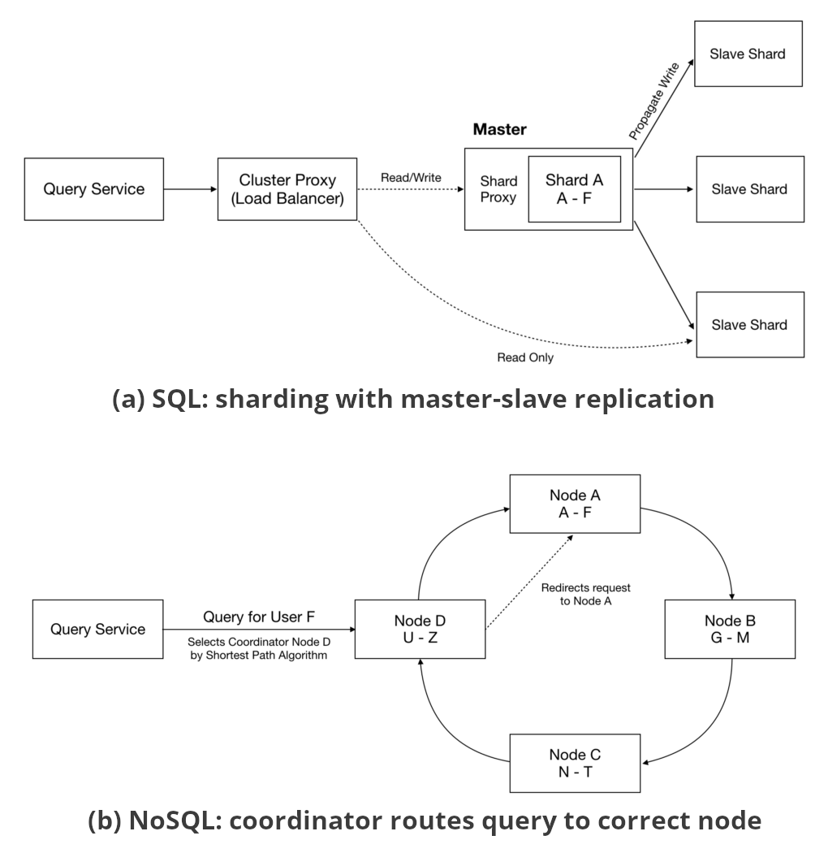
How is sharding different between SQL and NoSQL databases?
SQL Databases | NoSQL Databases
SQL databases were designed with ACID transactions in mind, not scalability. Therefore, in SQL only manual sharding is possible. | NoSQL databases were designed with scalability in mind. Therefore, NoSQL system has its own automatic sharding.
In SQL tables, shard key is based on one or more columns | In NoSQL records, one or more fields are used instead.
SQL databases combine sharding with replication, it's a master-slave architecture (The master node is responsible for handling write queries while slave nodes are responsible for handling read queries. Whenever write operation is performed on the master node, it is replicated to all the slave nodes to keep the data consistent across the entire system | In NoSQL world, shards are referred to as nodes. All nodes are equal, with one node connected to a few others in a graph-like structure. When a query comes in, a coordinator node is selected. If the coordinator can respond directly, it will. Otherwise, it forwards the query to another node that has the data. Nodes frequently share information about the data they store via what's called the gossip protocol

Slide 6
Database SCALING
Sreelekshmi Pulickichiraveli (8901347)

Slide 7
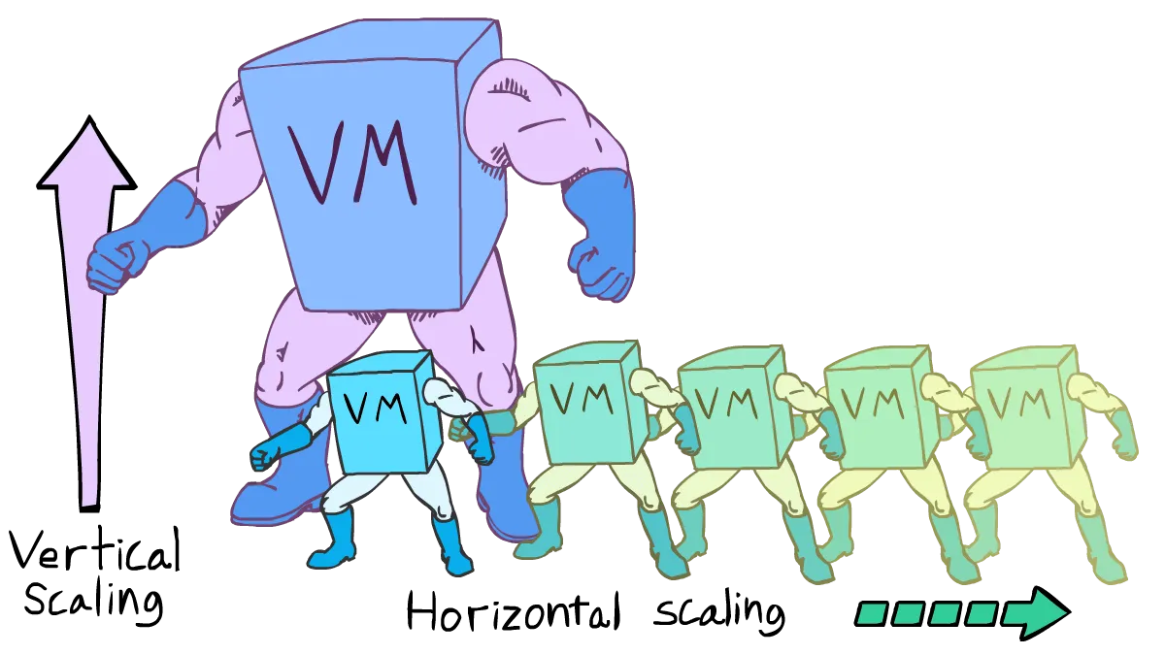
Scalability(Horizontal & vertical)
Ability of system to handle the increasing load without affecting its performance.
Vertical scaling
Also known as Scale-up
Increase the resources of single machine to handle the load.(like CPU, memory, storage etc.)
Horizontal scaling
Also known as Scale-out
Adding additional machines to handle the load
Fig: https://vaibhhavrajkumar.medium.com/horizontal-vs-vertical-scaling-2a5c9fd71eaf

Slide 8
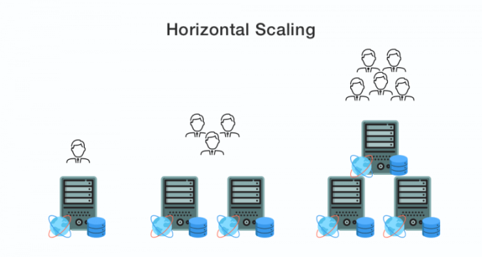
Horizontal Scalability and NoSQL
Distributed architecture of NoSQL database supports the horizontal scalability
Allows data to be partitioned and spread across various nodes in a cluster.
With help of sharding technique, we can divide the data into manageable shards and store it in multiple servers.
Increase the system performance and fault tolerance
Fig: https://piyushchaudhariblog.wordpress.com/2018/11/28/vertical-scaling-and-horizontal-scaling-in-aws/

Slide 9
NoSQL features support scaling
Dynamic scaling, which allows to add or remove nodes from the cluster based on the requirements
Auto-scaling – automatically adjust the number of nodes based on load.
Load balancing – Ensures that the loads are distributed equally among the nodes

Slide 10
Database SHARDING & SCALING
Himani Sharma (8900201)

Slide 11
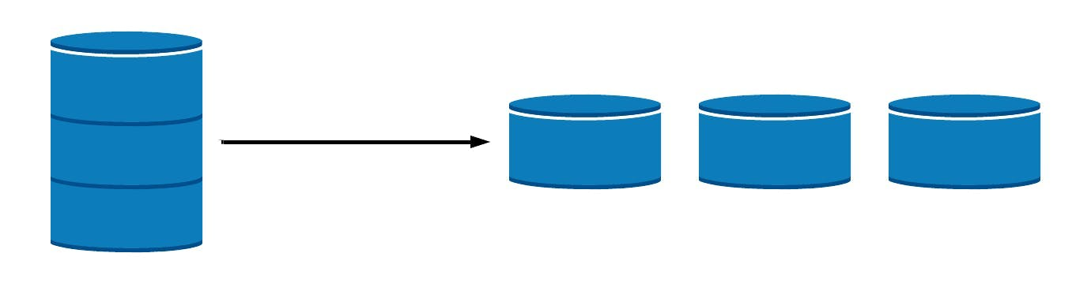
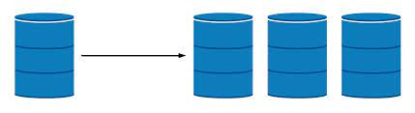
Brief Overview of SHARDING AND SCALING
Sharding Definition:
Sharding is a technique used in the context of databases to distribute and partition data over numerous database instances or servers, often known as "shards." Sharding is primarily used to expand data storage capacity, improve database speed, and distribute database load over numerous workstations.
Scaling Definition:
Scaling in databases refers to the process of increasing the capacity of a database system to handle more data, transactions, and user requests while maintaining acceptable performance and response times. Scaling is critical for applications that face gradual increases in data volume or user traffic.
How Companies are Using These Techniques
Amazon uses scaling to handle millions of transactions per day
START
END
Amazon and Scaling
Facebook and Sharding
Facebook uses sharding to handle billions of users.

Slide 12









Key Differences Between Sharding and Scaling
Sharding
Scaling
Database design strategy to partition and distribute data across multiple servers (shards)
Process of increasing a system's capacity to handle a larger load or accommodate growing demands
Improve database performance, increase data storage capacity, and distribute the database load
Maintain performance and handle increased traffic, users, or data without sacrificing system responsiveness
Data Distribution via Horizontal Scaling
Resource Allocation via Vertical or Horizontal Scaling
Splits data across shards based on a sharding key
Utilizes multiple resources in a single server or adds more servers to distribute load
Requires careful handling of data consistency and synchronization across shards
Provides consistent data within a single server or shared resource
Requires additional planning and coordination, may introduce complexities for cross-shard operations
Generally simpler to implement, but may have practical hardware limitations
Can provide built-in redundancy and high availability if implemented correctly
May not inherently provide redundancy, but can be combined with redundancy strategies
Offers better flexibility in handling sudden traffic spikes and future growth
May have limitations on how much the system can be scaled vertically

Slide 13




Pros and Cons of Sharding and Scaling
Pros of Sharding
Cons of Sharding
Pros of Scaling
Cons of Scaling
Improved performance
Greater availability
Cost-effective
Redundancy and High Availability
Enhanced User Experience
Geographical Distribution
Limited capacity
Potential for downtime
Technical complexity
Cost
Single Points of Failure
Application Compatibility
Overhead for Small Datasets
Improved performance
Greater availability
Enhanced security
Scalability
Cost effective
Geographical distribution
Complexity
Higher costs
Potential for data loss
Data Distribution Complexity
Increased Complexity
Complications in Backup and Restore

Slide 14
Database performance
Presenter-Veerpal KAUR(8901084)

Slide 15

Introduction
Performance refers to the efficiency, effectiveness and quality of a particular process, task, or system. The performance of a database refers to its ability to handle data storage, retrieval, manipulation, and processing tasks efficiently and effectively.
Several factors on which a performance of database can judged such as:
- Latency: The amount of time it takes for one operation (such as a read or write) to be finished.
- Throughput: How many operations a database can process in each amount of time.
- Response Time: Time Taken to address a user's request.
- Concurrency: To handle multiple concurrent connections and transactions without conflicts for many users simultaneously

Slide 16
Factors Affecting Database Performance
Hardware and Infrastructure: Performance of database dependents on the hardware factors such as CPU, RAM, storage type (SSD vs. HDD), network bandwidth, and disk I/O speed. Infrastructure can affect how quickly the database can process queries and retrieve data.
Data Modeling and Schema Design: Well-designed schema is needed as it reduces data redundancy. Proper use of normalization, denormalization, as well as relationships between data entities should be proper to improve the performance.
Query Optimization: Query Optimization can be used to choose the best execution plan for a given query by selecting appropriate indexes, join methods, and access paths to minimize execution time.
Scalability: Database should scale gracefully when the size of data size and number of users increase. Scaling can be vertical or horizontal. Vertical scalability involves upgrading hardware resources of a single server, while horizontal scalability involves distributing the data and workload across multiple servers.
Buffering and Caching: Effective use of buffer pools and caching mechanisms can reduce disk I/O and improve overall performance by keeping recent data in memory.
Backup and Recovery: Better backup and recovery mechanisms is needed to ensure that data can be restored in case of hardware failures or other disasters without significant downtime.
Database Maintenance: Regularly performing database maintenance tasks, such as index rebuilding, statistics updates, and data vacuuming. This would help to keep the database running efficiently.
Monitoring and Profiling: Regularly monitoring database performance and profiling queries can be done to identify performance bottlenecks and areas for improvement. Database performance monitoring software tools can provide insights about resource usage, slow queries, and other metrics that impact performance.

Slide 17
Popular database management systems
MongoDB is a document-oriented NoSQL database that is known for its flexibility and ease of use.
Performance: MongoDB is generally optimized for read-heavy workloads and can perform well with complex as it supports indexes. It is efficient in handling large amounts of unstructured or semi-structured data.
Cassandra is a distributed NoSQL database designed for high availability and horizontal scalability.
Performance: Cassandra is designed to handle high write and read throughput. It's suitable for managing large amounts of data across multiple data centers.
CouchDB is a NoSQL database that stores data in JSON format and provides a RESTful HTTP interface for data access.
Performance: CouchDB is well-suited for decentralized environments and offline availability. It has good performance for read-heavy workloads when data replication is needed across multiple devices or locations.
Hadoop is a distributed data processing framework that includes the Hadoop Distributed File System (HDFS) for storage.
Performance: Hadoop is primarily designed for batch processing and handling large-scale data analytics. It is well-suited for processing vast amounts of data across distributed computing clusters but might not be ideal for low-latency real-time applications.
CONCLUSION
In conclusion, Database performance is essential for applications and systems to deliver timely responses, handle concurrent users, and scale effectively as the data and workload grow.
Database performance involves careful consideration of database design, query optimization, caching, hardware choices, and scalability measures to ensure the system can handle the expected workload while providing quick and responsive access to data. Regular monitoring, maintenance, and optimization are crucial to maintaining high database performance over time.

Slide 18

ANY QUESTIONS ?
THANK YOU
REFERENCES
The 5 Key Factors for Database Performance. (2019, October 31). Database Trends and Applications. https://www.dbta.com/Columns/DBA-Corner/The-5-Key-Factors-for-Database-Performance-134830.aspx
Elphick, E. (2022, May 2). 8 Database Performance Tuning Techniques. Buchanan Technologies. https://www.buchanan.com/database-performance-tuning-techniques/
Amazon Web Services. (2019). What is NoSQL? | Nonrelational Databases, Flexible Schema Data Models | AWS. Amazon Web Services, Inc. https://aws.amazon.com/nosql/

